Slide 1
Lets learn C

Slide 2
#include <stdio.h>
int main() {
printf("Hello, World!\n");
return 0;
}

Slide 3
Compilation Process

Slide 4
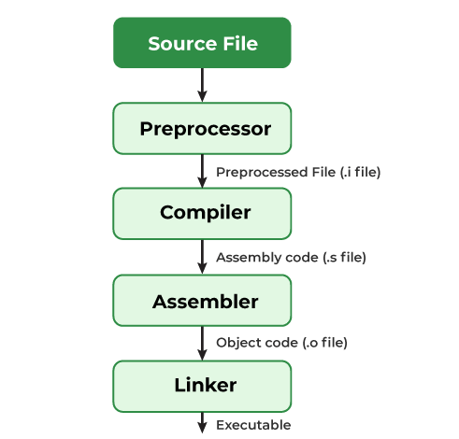

Slide 5
Lexicon, Syntax
and Semanatics

Slide 6
Variables and Data Types

Slide 7
Arithmetic Operators and
Arithmetic Expressions

Slide 8
Conditional Branching

Slide 9
Relational Operator

Slide 10
Mixed Operand

Slide 11
Assignment Operator

Slide 12
Bit Operations

Slide 13
Operator Precedence

Slide 14
Postfix operators (e.g., ++, --)
Unary operators (e.g., +, -, !, ~, ++, --, sizeof, &, *)
Multiplicative operators (e.g., *, /, %)
Additive operators (e.g., +, -)
Shift operators (e.g., <<, >>)
Relational operators (e.g., <, >, <=, >=)
Equality operators (e.g., ==, !=)
Bitwise AND (&) Bitwise XOR (^) Bitwise OR (|)
Logical AND (&&) Logical OR (||)
Conditional (Ternary) Operator (? :)
Assignment operators (e.g., =, +=, -=, *=, /=, %=)
Comma operator (,)

Slide 15
Operator Associativity

Slide 16
Structure of C program

Slide 17
Components of C Program

Slide 18
Input/Output Functions

Slide 19
Switch Statement

Slide 20
Nesting If and Else

Slide 21
Break and Default

Slide 22
while, do-while and for loops

Slide 23
Functions

Slide 24
Types of Functions

Slide 25
Nesting

Slide 26
Recursion and Recursive Functions

Slide 27
Arrays

Slide 28
Multidimensional Array

Slide 29
String

Slide 30
Pointers

Slide 31
Pointer Arithmetic

Slide 32
Dynamic Memory Allocation

Slide 33
Structures

Slide 34
Unions

Slide 35
Structure vs Union

Slide 36
Macros

Slide 37
File Handling

Slide 38
File Pointers

Slide 39
File Handling Functions

Slide 40
Happy Coding...

